Slide 1

DREAM DESTINATIONS GETAWAYS
Presented by Tiny Coders
Team Members
Erika Valle-Baird
Domeniko Kondra
Mohammed Khoshkoiyazdi
Madison Bilko
Collin Cavanaugh
Tamara Greer

Slide 2

Design Information
Our design pattern consists of a combination of
CONTROLLERS
working with
CLASSES
WHY?
Because of the need for
Database Servers
Third Party Card Processing Site
Database Information
Communication
between:

Slide 3

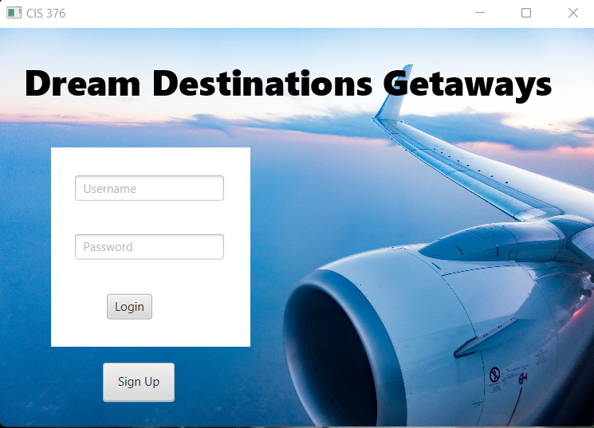
Login Page
Here is a view of our main login page. We plan to use this layout, however due to time constraints went with a simpler look to avoid complications.

Slide 4
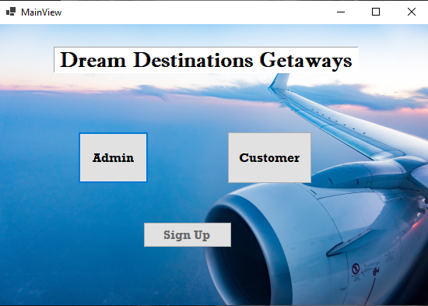
Main View Login Page
BUTTONS:
Sent to Admin View Page
Admin:
Sent to Customer Home
View Page
Customer:
Sent to Account
Registration View Page
Sign Up:

Slide 5

Main Controller
METHODS:
private void handleCustomerLogin(ActionEvent event) {
customerLogin.setOnMouseClicked(new EventHandler<MouseEvent>(){
@Override
public void handle(MouseEvent t) {
Parent homePage;
try {
homePage = FXMLLoader.load(getClass().getResource("Home.fxml"));
Scene homeScene = new Scene(homePage);
} catch (IOException ex) {
Logger.getLogger(TravelVacationFXMLController.class.getName()).log(Level.SEVERE, null, ex);}}});}
private void handleAdminLogin(ActionEvent event) {
admin.setOnMouseClicked(new EventHandler<MouseEvent>(){
@Override
public void handle(MouseEvent t) {
try {
Parent homePage = FXMLLoader.load(getClass().getResource("UserManagement.fxml"));
Scene homeScene = new Scene(homePage);
} catch (IOException ex) {
Logger.getLogger(TravelVacationFXMLController.class.getName()).log(Level.SEVERE, null, ex);}} }); }
private void handleSignUp(ActionEvent event) {
signUp.setOnMouseClicked(new EventHandler<MouseEvent>(){
@Override
public void handle(MouseEvent t) {
try {
Parent homePage = FXMLLoader.load(getClass().getResource("AccountRegistration.fxml"));
Scene homeScene = new Scene(homePage);
} catch (IOException ex) {
Logger.getLogger(TravelVacationFXMLController.class.getName()).log(Level.SEVERE, null, ex); } }});}}
ATTRIBUTES:
Button customerLogin;
Button admin;
Button signUp;

Slide 6
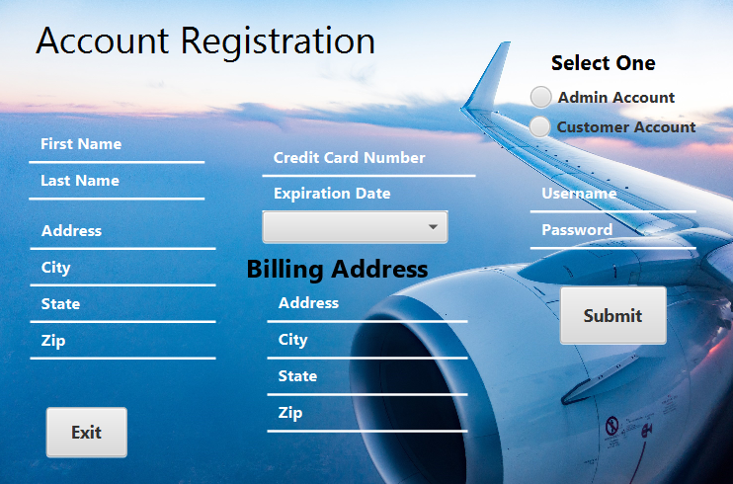
Account Registration View
BUTTONS:
Creates an Admin
User Account
Admin Account:
Creates a Customer
User Account
Customer Account:
Saves Information in the
Database and Sends User
To Page View Based on
Type of Account Selected
Submit:
Exits by Closing Window
Exit:

Slide 7
Account Registration Controller
METHODS:
Account Registration Controller
private void handleSubmit(MouseEvent event) throws IOException{
firstName.getText();
lastName.getText();
address.getText();
city.getText();
state.getText();
zip.getText();
creditCardNumber.getText();
expirationDate.getText();
billAddress.getText();
billCity.getText();
billState.getText();
billZip.getText();
username.getText();
password.getText();
Parent homePage = FXMLLoader.load(getClass().getResource("Home.fxml"));
Scene homeScene = new Scene(homePage);
Stage stage = (Stage)((Node)event.getSource()).getScene().getWindow();
stage.setScene(homeScene);
stage.show();}
private void handleCardType(MouseEvent event) {
cardType.getItems().addAll("Visa", "Mastercard", "Discover", "American Express");}
class CardTypes{ private String card;
public void CardTypes(String card){ card = card;}
public String toString(){ return card;} }}
ATTRIBUTES:
TextField firstName;
TextField lastName;
ChoiceBox<String> cardType = new ChoiceBox<String>();
TextField address;
TextField city;
TextField state;
TextField zip;
TextField creditCardNumber;
TextField expirationDate;
TextField billAddress;
TextField billCity;
TextField billState;
TextField billZip;
TextField username;
TextField password;
private Button customerAccount;
private Button adminAccount;

Slide 8
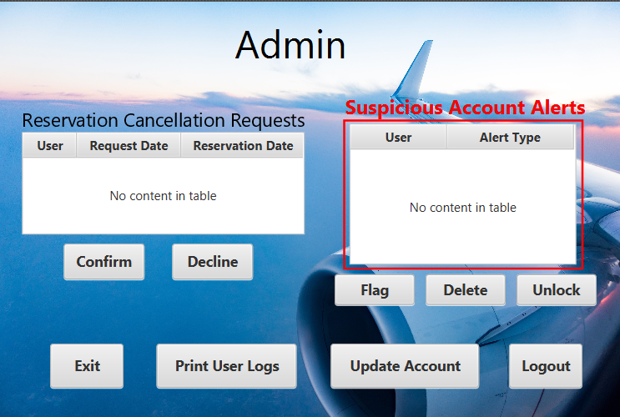
Admin View
BUTTONS:
Confirm Customer Cancellation
Request Selected in Table
confirm:
Decline Customer Cancellation
Request Selected in Table
decline:
Flag Account Selected in Table
flag:
Delete Account Selected in Table
Delete:
Unlock Account Selected in Table
unlock:
Exits by Closing Window
Exit:
Print User Logs Collected by
Database for User Management
Print user
logs:
Sends Admin to Update
Account Information
View Page
Update account
information:
Logs Out of Account and
Sends Back to Main View
logout:

Slide 9
User Management Controller
METHODS:
private void handleFlagAccount(ActionEvent event) {}
private void handleDeleteAccount(ActionEvent event) {customer.deleteCustomer(customerID);}
public static void deleteCustomer(Customer customer){
try{
s.executeUpdate("Delete Customer CustomerID = " + customer.getCustomerID() + ";");}
catch(Exception e){
e.printStackTrace();}}}
return CustomerTableItems;}}
private void handleConfirm(ActionEvent button) {
button.setOnAction(new EventHandler<ActionEvent>() {
public void handle(ActionEvent event) {
gridPane.getChildren().clear();
new Reservations(gridPane);}});}}
private void handleUpdateAccount(ActionEvent event) throws IOException{
//Move to Update Account
Parent homePage = FXMLLoader.load(getClass().getResource("UpdateAccountInformation.fxml"));
Scene homeScene = new Scene(homePage);
Stage stage = (Stage)((Node)event.getSource()).getScene().getWindow();
stage.setScene(homeScene);
stage.show();}
private void handleLogout(ActionEvent event) throws IOException{
Parent homePage = FXMLLoader.load(getClass().getResource("TravelVacation.fxml"));
Scene homeScene = new Scene(homePage);
Stage stage = (Stage)((Node)event.getSource()).getScene().getWindow();
stage.setScene(homeScene);
stage.show();}}
ATTRIBUTES:
TableView<?> alertTypeTable;
TableView<?> cancelRequestTable;

Slide 10
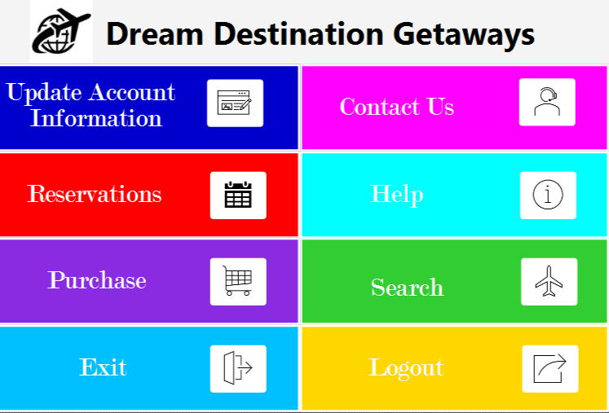
Customer Home View
BUTTONS:
Sends Customer to Contact
Us View Page
Contact us:
Logs Out of Account and
Sends Back to Main View
logout:
Sends Customer to Help View Page
help:
Exits by Closing Window
Exit:
Sends Customer to Update
Account Information
View Page
Update account
information:
Sends Customer to Flight
Search View Page
search:
Sends Customer to Purchase View
Page to Purchase Reservations
purchase:
Sends Customer to Reservations
View Page to View, Print, or
Cancel Reservations
reservations:

Slide 11
Home Controller
private void handlePurchase(ActionEvent event) throws IOException{
//Move to Purchase Controller and Page
Parent homePage = FXMLLoader.load(getClass().getResource("Purchase.fxml"));
Scene homeScene = new Scene(homePage);
Stage stage = (Stage)((Node)event.getSource()).getScene().getWindow();
stage.setScene(homeScene);
stage.show();}
private void handleLogout(ActionEvent event) throws IOException{
//Logout
Parent homePage = FXMLLoader.load(getClass().getResource("TravelVacation.fxml"));
Scene homeScene = new Scene(homePage);
Stage stage = (Stage)((Node)event.getSource()).getScene().getWindow();
stage.setScene(homeScene);
stage.show();}
private void handleHelp(ActionEvent event) throws IOException{
//Move to Help Controller and Page
Parent homePage = FXMLLoader.load(getClass().getResource("Help.fxml"));
Scene homeScene = new Scene(homePage);
Stage stage = (Stage)((Node)event.getSource()).getScene().getWindow();
stage.setScene(homeScene);
stage.show();}
private void handleAccountUpdate(ActionEvent event) throws IOException{
//Move to Update Account Information Controller and Page
Parent homePage = FXMLLoader.load(getClass().getResource("UpdateAccountInformation.fxml"));
Scene homeScene = new Scene(homePage);
Stage stage = (Stage)((Node)event.getSource()).getScene().getWindow();
stage.setScene(homeScene);
stage.show();}}
METHODS:
private void handleContactUs(ActionEvent event) throws IOException{
//Move to Contact Us Controller and Page
Parent homePage = FXMLLoader.load(getClass().getResource("ContactUs.fxml"));
Scene homeScene = new Scene(homePage);
Stage stage = (Stage)((Node)event.getSource()).getScene().getWindow();
stage.setScene(homeScene);
stage.show();}
private void handleReservation(ActionEvent event) throws IOException{
//Move to Reservation Controller and Page
Parent homePage = FXMLLoader.load(getClass().getResource("Reservation.fxml"));
Scene homeScene = new Scene(homePage);
Stage stage = (Stage)((Node)event.getSource()).getScene().getWindow();
stage.setScene(homeScene);
stage.show();}
private void handleFlightSearch(ActionEvent event) throws IOException {
//Move to Flight Search Controller and Page
Parent homePage = FXMLLoader.load(getClass().getResource("FlightSearch.fxml"));
Scene homeScene = new Scene(homePage);
Stage stage = (Stage)((Node)event.getSource()).getScene().getWindow();
stage.setScene(homeScene);
stage.show();}

Slide 12
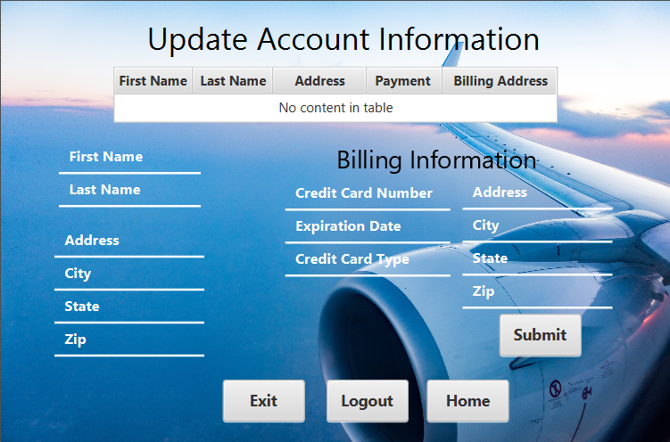
Update Account Information View
BUTTONS:
Sends User
To Page View Based on
Type of Account Selected
Home:
Updates Information in the
Database and Sends User
To Page View Based on
Type of Account Selected
Submit:
Logs Out of Account and
Sends Back to Main View
logout:
Exits by Closing Window
Exit:

Slide 13
Update Account Information Controller
METHODS:
private void handleSubmit(ActionEvent event) throws IOException{
firstName.getText();
lastName.getText();
address.getText();
city.getText();
state.getText();
zip.getText();
creditCardNumber.getText();
expirationDate.getText();
billAddress.getText();
billCity.getText();
billState.getText();
billZip.getText();
cardType.getText();
if(isInt(zip, "You must enter a Valid Zip Code"));
Parent homePage = FXMLLoader.load(getClass().getResource("Home.fxml"));
Scene homeScene = new Scene(homePage);
Stage stage = (Stage)((Node)event.getSource()).getScene().getWindow();
stage.setScene(homeScene);
stage.show();}
private void handleLogout(ActionEvent event) throws IOException{
Parent homePage = FXMLLoader.load(getClass().getResource("TravelVacation.fxml"));
Scene homeScene = new Scene(homePage);
Stage stage = (Stage)((Node)event.getSource()).getScene().getWindow();
stage.setScene(homeScene);
stage.show();}
private boolean isInt(TextField f, String msg){
try{
Integer.parseInt(f.getText());
return true;}
catch(NumberFormatException e){
return false;}}}
ATTRIBUTES:
TableView<?> currentAccountInformation;
TextField firstName;
TextField lastName;
TextField address;
TextField city;
TextField state;
TextField zip;
TextField billAddress;
TextField billCity;
TextField billState;
TextField billZip;
TextField creditCardNumber;
TextField expirationDate;
TextField cardType;

Slide 14
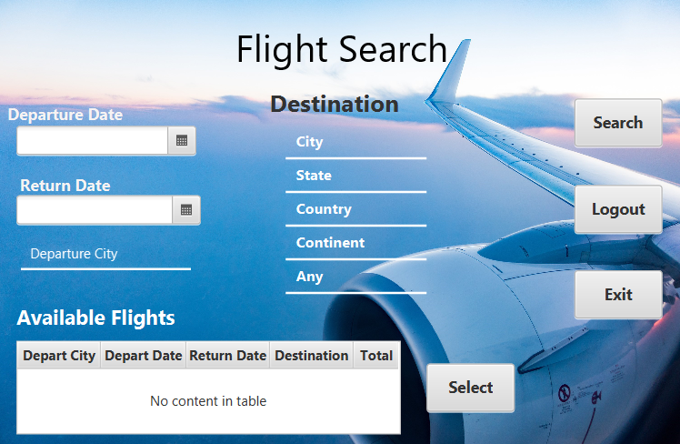
Flight Search View
BUTTONS:
Searches for Flights Based on
Customer Input and Displays
Under Available Flights
search:
Logs Out of Account and
Sends Back to Main View
logout:
Exits by Closing Window
Exit:
Selects Flights Checked by
Customer in Table and Sends
Customer and Flight Selection
to Purchase Page
Select:

Slide 15
Flight Search Controller
METHODS:
public void initialize(URL url, ResourceBundle rb) {
departDate.getText();
returnDate.getText();
departCity.getText();
arriveContient.getText();
arriveCountry.getText();
arriveCity.getText(); arriveState.getText();}
private void handleSelectButton(ActionEvent event) throws IOException{
Parent purchasePage = FXMLLoader.load(getClass().getResource("Purchase.fxml"));}
private void handleSearchButton(ActionEvent event) {}
private void handleHome(ActionEvent event) throws IOException{
Parent homePage = FXMLLoader.load(getClass().getResource("Home.fxml"));
Scene homeScene = new Scene(homePage);
Stage stage = (Stage)((Node)event.getSource()).getScene().getWindow();
stage.setScene(homeScene);
stage.show();}
private void handleLogout(ActionEvent event) throws IOException{
Parent homePage = FXMLLoader.load(getClass().getResource("TravelVacation.fxml"));
Scene homeScene = new Scene(homePage);
Stage stage = (Stage)((Node)event.getSource()).getScene().getWindow();
stage.setScene(homeScene);
stage.show();}}
ATTRIBUTES:
DatePicker departDate;
DatePicker returnDate;
TextField departCity;
TableView<?> flightSearchResults;
Button selectButton;
Button searchButton;
TextField arriveContient;
TextField arriveCountry;
TextField arriveCity;
TextField arriveState;

Slide 16
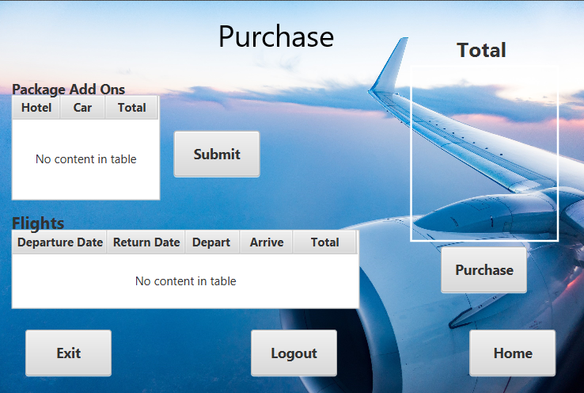
Purchase View
BUTTONS:
Sent to Customer Home
View Page
Home:
Exits by Closing Window
Exit:
Logs Out of Account and
Sends Back to Main View
logout:
Submits Package and Flight
Selections to Bill Total
Submit:
Purchases Package & Flight
Selections by Sending to
Third Party Card
Processing To Complete
Transaction, After
Transaction Complete
Reservation will be Available
In Reservation View Page
purchase:

Slide 17
Purchase Controller
METHODS:
private void handleHome(ActionEvent event) throws IOException{
Parent homePage = FXMLLoader.load(getClass().getResource("Home.fxml"));
Scene homeScene = new Scene(homePage);
Stage stage = (Stage)((Node)event.getSource()).getScene().getWindow();
stage.setScene(homeScene);
stage.show();}
private void handleLogout(ActionEvent event) throws IOException{
//Logout
Parent homePage = FXMLLoader.load(getClass().getResource("TravelVacation.fxml"));
Scene homeScene = new Scene(homePage);
Stage stage = (Stage)((Node)event.getSource()).getScene().getWindow();
stage.setScene(homeScene);
stage.show();}}
private void handleAddOns(ActionEvent event) {
CarRentalTable flight = new CarRentalTable();
for (CarRentalTable c : CarRentalTableInformation.get CarRentalTableTableItems()) {
if(Reservation.getCarRentalTableID() == c.getCarRentalTableID()) {
carRental = c;
break;}}
routeBox.setValue(carRental.getArriveCity());
setDatePicker();
departureDatePicker.setValue(LocalDate.paresultse(carRental.getArriveDate()));
int price = getCarRentalPrice() + getHotelPrice();}
private void handlePurchase(ActionEvent event) throws IOException{
//Connect to third part processing site for payment verification, validation, etc
reservationList.getReservations().get(customer).getFlightID().getHotelID().getCarRentalID();}
public void initialize(URL url, ResourceBundle rb) {
flightList.getFlights().get(flightList).getDepartDate().getReturnDate().getDepartLocation().getArriveLocation().getTotal();
carRentals.getCarRentals().get(carRentals).getArriveDate().gettDepartDate().getArriveLocation().getTotal();
hotels.getHotels().get(hotels).getArriveDate().getArriveDate().gettDepartDate().getArriveLocation().getTotal(); }
ATTRIBUTES:
ArrayList<Flight> flightList;
ArrayList<Hotel> hotels;
ArrayList<CarRentals> carRentals;
ArrayList<Reservations> reservationList;
Label theLabel;
TableView<?> flightList;
TableView<?> packageList;
BorderPane total;

Slide 18
Update Account Information View
BUTTONS:
Submits Updated
Information to Database
and Sends User to their
Home Page
submit:
Exits by Closing Window
Exit:
Logs Out of Account
And Sends Back to
Main View
logout:
If Logged in under Admin-
Sent to Admin View
If Customer-
Sent to Customer Home View
home:

Slide 19
Update Account Information Controller
private void handleSubmit(ActionEvent event) throws IOException{
firstName.getText();
lastName.getText();
address.getText();
city.getText();
state.getText();
zip.getText();
creditCardNumber.getText();
expirationDate.getText();
billAddress.getText();
billCity.getText();
billState.getText();
billZip.getText();
cardType.getText();
if(isInt(zip, "You must enter a Valid Zip Code"));
Parent homePage = FXMLLoader.load(getClass().getResource("Home.fxml"));
Scene homeScene = new Scene(homePage);
Stage stage = (Stage)((Node)event.getSource()).getScene().getWindow();
stage.setScene(homeScene);
stage.show();}
private void handleLogout(ActionEvent event) throws IOException{
Parent homePage = FXMLLoader.load(getClass().getResource("TravelVacation.fxml"));
Scene homeScene = new Scene(homePage);
Stage stage = (Stage)((Node)event.getSource()).getScene().getWindow();
stage.setScene(homeScene);
stage.show();}
METHODS:
private boolean isInt(TextField f, String msg){
try{
Integer.parseInt(f.getText());
return true;}
catch(NumberFormatException e){
return false;}}}
ATTRIBUTES:
TextField firstName;
TextField lastName;
TextField address;
TextField city;
TextField state;
TextField zip;
TextField billAddress;
TextField billCity;
TextField billState;
TextField billZip;
TextField creditCardNumber;
TextField expirationDate;
TextField cardType;

Slide 20
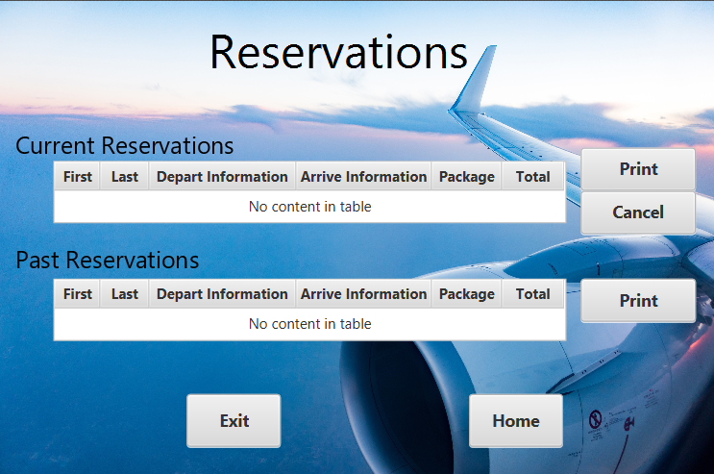
Reservations View
BUTTONS:
Prints Current Reservations
print:
Sends a Request To Admin
To Cancel Current
Reservations
cancel:
Prints Past Reservations
print:
Exits by Closing Window
Exit:
Sent to Customer Home
View Page
Home:

Slide 21
Reservations Controller
METHODS:
public void initialize(URL url, ResourceBundle rb) {
currentReservations.getReservation();
firstName.getFirstName();
lastName.getLastName();
departInfo.getDepartInfo ();
arriveInfo.getArriveInfo ();
packageInfo.getPackageInfo ();
total.getTotal();}
private void handleHome(ActionEvent event) throws OException{
Parent homePage = FXMLLoader.load(getClass().getResource("Home.fxml"));
Scene homeScene = new Scene(homePage);
Stage stage = (Stage)((Node)event.getSource()).getScene().getWindow();
stage.setScene(homeScene);
stage.show();}
private void handleLogout(ActionEvent event) throws IOException{
Parent homePage = FXMLLoader.load(getClass().getResource("TravelVacation.fxml"));
Scene homeScene = new Scene(homePage);
Stage stage = (Stage)((Node)event.getSource()).getScene().getWindow();
stage.setScene(homeScene);
stage.show();}}
public static Reservation getReservation() {return Reservation;}
public static boolean isOkPressed() {return okPressed;}
private void handlePrintPast(ActionEvent event) {}
private void handlePrintCurrent(ActionEvent event) {}
private void handleCancelCurrent(ActionEvent event) {admin.requestCancel();}
ATTRIBUTES:
ArrayList<Reservations> reservationList = new
ArrayList<Reservations>();
TableView<?> currentReservations;
TableColumn<?, ?> firstName;
TableColumn<?, ?> lastName;
TableColumn<?, ?> departInfo;
TableColumn<?, ?> arriveInfo;
TableColumn<?, ?> packageInfo;
TableColumn<?, ?> total;
TableView<?> pastReservations;
ComboBox<String> customerBox;
ComboBox<String> routeBox;
DatePicker departureDatePicker;
Button addCustomer;
Button okButton;
Button cancelButton;
Label priceLabelObs;
boolean okPressed = false;
Reservation Reservation;
ReservationTable ReservationTable;

Slide 22

Contact Us View
BUTTONS:
Sent to Customer Home
View Page
Home:
Exits by Closing Window
Exit:

Slide 23
Contact Us Controller
METHODS:
private void handleHome(ActionEvent event) throws IOException{
Parent homePage = FXMLLoader.load(getClass().getResource("Home.fxml"));
Scene homeScene = new Scene(homePage);
Stage stage = (Stage)((Node)event.getSource()).getScene().getWindow();
stage.setScene(homeScene);
stage.show();}}

Slide 24
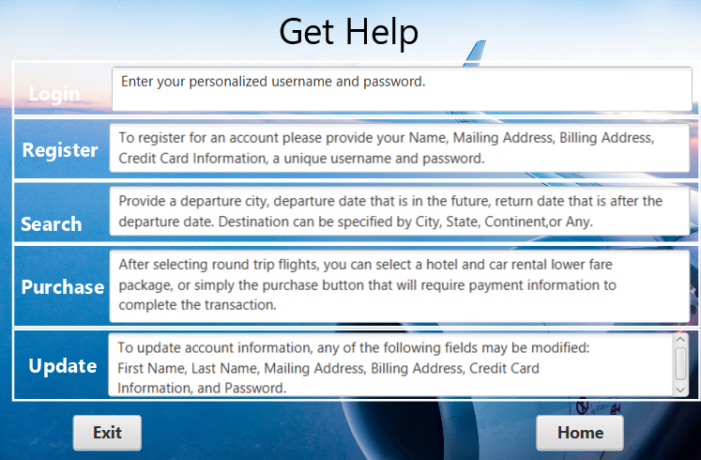
Get Help View
BUTTONS:
Sent to Customer Home
View Page
Home:
Exits by Closing Window
Exit:

Slide 25
Get Help Controller
METHODS:
private void handleHome(ActionEvent event) throws IOException{
Parent homePage = FXMLLoader.load(getClass().getResource("Home.fxml"));
Scene homeScene = new Scene(homePage);
Stage stage = (Stage)((Node)event.getSource()).getScene().getWindow();
stage.setScene(homeScene);
stage.show();}

Slide 26
Classes

Slide 27
CLASS: Admin
ATTRIBUTES:
METHODS:
int adminID;
String firstName;
String lastName;
String password;
public Admin() {}
public Admin(int adminID, String firstName, String lastName, String password) {
this.adminID = adminID;
this.firstName = firstName;
this.lastName = lastName;
this.password = password;}
public int getAdminID() {return adminID;}
public void setAdminID(int adminID) {this.adminID = adminID;}
public String getFirstName() { return firstName;}
public void setFirstName(String firstName) {this.firstName = firstName;}
public String getLastName() {return lastName;}
public void setLastName(String lastName) { this.lastName = lastName;}
public String getPassword() {return password;}
public void setPassword(String password) {this.password = password;}}
Get and Set Methods to Access Admin Information

Slide 28
CLASS: Airline
ATTRIBUTES:
METHODS:
int airlineID;
String departCity;
String arrivalCity;
public Airline(){}
public Airline(int airlineID, String departCity, String arrivalCity){
this.airlineID = airlineID;
this.departCity = departCity;
this.arrivalCity = arrivalCity;}
public int getAirlineID() {return airlineID;}
public void setAirlineID(int airlineID) {this.airlineID = airlineID;}
public String getDepartCity() {return departCity;}
public void setDepartCity(String departCity) {this.departCity =departCity;}
public String getArrivalCity() {return arrivalCity;}
public void setArrivalCity(String arrivalCity) {this.arrivalCity = arrivalCity;}}
Get and Set methods to access Airline Information

Slide 29
CLASS: Customer
ATTRIBUTES:
METHODS:
int customerID;
String firstName;
String lastName;
String address;
String city;
String state;
int zip;
int creditCardNumber;
int expirationDate;
String billAddress;
String billCity;
String billState;
int billZip;
public Customer() { }
public Customer( int customerID, String firstName, String lastName, String address, String city, String state, int zip, int creditCardNumber, int expirationDate, String billAddress, String billCity, String billState, int billZip){
this.customerID = customerID;
this.firstName = firstName;
this.lastName = lastName;
this.address = address;
this.city= city;
this.state= state;
this.zip =zip;
this.creditCardNumber = creditCardNumber;
this.expirationDate = expirationDate;
this.billAddress= billAddress;
this.billCity= billCity;
this.billState= billState;
this.billZip = billZip;}

Slide 30
CLASS: Customer (Con’t)
public int getCustomerID() {return customerID;}
public void setCustomerID(int customerID) {this.customerID = customerID;}
public String getFirstName() {return firstName;}
public void setFirstName(String firstName) { this.firstName = firstName;}
public String getLastName() {return lastName;}
public void setLastName(String lastName) {this.lastName = lastName;}
public String getAddress() {return address;}
public void setAddress(String address) {this.address = address;}
public String getCity() {return city;}
public void setCity(String city) {this.city = city;}
public String getState() {return state;}
public void setState(String state) {this.state = state;}
public int getZip() {return zip;}
public void setZip(int zip) {this.zip = zip;}
public void setBillState(String billState) {this.billState = billState;}
public int getBillZip() {return billZip;}
public void setBillZip(int billZip) {this.billZip = billZip;}}
METHODS:
public int getCreditCardNumber() {return creditCardNumber;}
public void setCreditCardNumber(int creditCardNumber) {this.creditCardNumber = creditCardNumber;}
public int getExpirationDate() {return expirationDate;}
public void setExpirationDate(int expirationDate) {this.expirationDate = expirationDate;}
public String getBillAddress() {return billAddress;}
public void setBillAddress(String billAddress) {this.billAddress = billAddress;}
public String getBillCity() {return billCity;}
public void setBillCity(String billCity) { this.billCity = billCity;}
public String getBillState() {return billState;}
Get and Set Methods to Access Customer Information

Slide 31
CLASS: FlightTable
ATTRIBUTES:
METHODS:
int flightID;
String departDate;
String departCity;
String arrivalCity;
Double price;
public FlightTable() {}
public FlightTable(String departDate, String departCity, String arrivalCity, double price, int flightID, int economyLeft, int coachLeft, int firstClassLeft){
this.departDate = departDate;
this.departCity = departCity;
this.arrivalCity = arrivalCity;
this.price = price;
this.flightID = flightID;}
public int getFlightID() {return flightID;}
public void setFlightID(int flightID) {this.flightID = flightID;}
public String getDepartDate() {return departDate;}
public void setDepartDate(String departDate) {this.departDate = departDate;}
public String getDepartCity() {return departCity;}
public void setDepartCity(String departCity) {this.departCity = departCity;}
public String getArrivalCity() {return arrivalCity;}
public void setArrivalCity(String arrivalCity) { this.arrivalCity = arrivalCity;}
public double getPrice() {return price;}
public void setPrice(double price) {this.price = price;}}
Get and Set Methods to Access Flight Table Data

Slide 32
CLASS: InformationConnection
ATTRIBUTES:
Connection connection;
String JDBCDRIVER = "com.mysql.jdbc.Driver";
String INFORMATIONBASE_URL = "jdbc:mysql://localhost:376/MyVacation?autoReconnect=true&useSSL=false";
String userName = UserPersonal.getUserName();
String password = UserPersonal.getPassword();
METHODS:
public static void connect() {
try {
Class.forName(JDBCDRIVER);
connection = DriverManager.getConnection(INFORMATIONBASE_URL, userName, password);
System.out.println("Informationbase connection success");}
catch (Exception e) {
e.printStackTrace();
System.out.println("ERROR WITH CONNECTION");}}
public static Connection getConnection() {return connection;}}

Slide 33
CLASS: Reservation
ATTRIBUTES:
METHODS:
int ReservationID;
int customerID;
int flightID;
int hotelID;
int carRentalID;
public class ReservationTable {
private int ReservationID;
private String departDate;
private String route;
private String customer;
public ReservationTable() {}
public ReservationTable(int ReservationID, String departDate, String route, String customer) {
this.ReservationID = ReservationID;
this.departDate = departDate;
this.route = route;
this.customer = customer;}
public int getReservationID() {return ReservationID;}
public void setReservationID(int ReservationID) {this.ReservationID = ReservationID;}
public String getDepartDate() {return departDate;}
public void setDepartDate(String departDate) {this.departDate = departDate; }
public String getRoute() {return route;}
public void setRoute(String route) {this.route = route;}
public String getCustomer() {return customer;}
public void setCustomer(String customer) {this.customer = customer; }}
Get and Set Methods to Access Reservations

Slide 34
CLASS: Schedule
ATTRIBUTES:
METHODS:
int scheduleID;
Date departDate;
String departTime;
Date arrivalDate;
String arrivalTime;
public Schedule(){
departDate = new Date();
arrivalDate = new Date();
departTime = "5:00";
arrivalTime = "9:00";}
public Schedule(int scheduleID, Date departDate, String departTime, Date arrivalDate, String arrivalTime) {
this.scheduleID = scheduleID;
this.departDate = departDate;
this.departTime = departTime;
this.arrivalDate = arrivalDate;
this.arrivalTime = arrivalTime;}
public int getScheduleID() {return scheduleID;}
public void setScheduleID(int scheduleID) {this.scheduleID = scheduleID;}
public Date getDepartDate() {return departDate;}
public void setDepartDate(Date departDate) {this.departDate = departDate;}
public String getDepartTime() {return departTime;}
public void setDepartTime(String departTime) {this.departTime = departTime;}
public Date getArrivalDate() {return arrivalDate;}
public void setArrivalDate(Date arrivalDate) {this.arrivalDate = arrivalDate;}
public String getArrivalTime() {return arrivalTime;}
public void setArrivalTime(String arrivalTime) {this.arrivalTime = arrivalTime;}}
Get and Set Methods to Access Flight Schedule

Slide 35
CLASS: UserPersonal
ATTRIBUTES:
String userName = "user";
String password = "1234";
METHODS:
Get and Set Methods to Access Username and Password
public static String getUserName() { return userName;}
public static String getPassword() {return password;}}

Slide 36
CLASS: FlightInformation
public static ObservableList<Flight> getFlight(){
flights = FXCollections.observableArrayList();
try{
s = InformationConnection.getConnection().createStatement();
ResultSet results = s.executeQuery(“Select flight");
if(results != null)
while (results.next()) {
Flight flight = new Flight();
flight.setFlightID(results.getInt(1));
flight.setPlaneID(results.getInt(2));
flight.setAirlineID(results.getInt(3));
flight.setScheduleID(results.getInt(4));
flight.setPrice(results.getDouble(8));
flights.add(flight);}}
catch(Exception e){
e.printStackTrace();}
return flights;}
ATTRIBUTES:
METHODS:
Statement s;
ObservableList<Flight> flights;
public static void insertFlight(Flight flight){
try{
s.executeUpdate("INSERT INTO flight VALUE(default, " + flight.getPlaneID() + ", " + flight.getAirlineID() + ", " + flight.getScheduleID() + ", " , " + flight.getPrice() +");");}
catch(Exception e){
e.printStackTrace();}}
public static void updateFlight(Flight flight){
try{
s.executeUpdate("UPDATE flight SET planeID = "+flight.getPlaneID()+", scheduleID = "+flight.getScheduleID()+", airlineID = "+flight.getAirlineID() +flight.getPrice()+" WHERE flightID = "+flight.getFlightID()+ ";");}
catch(Exception e){
e.printStackTrace();}}

Slide 37
Server SIde

Slide 38
CLASS: Customer
METHODS:
public static ObservableList<Customer> getCustomerInfo(){
customerInfo = FXCollections.observableArrayList();
try{
s = InformationConnection.getConnection().createStatement();
ResultSet results = s.executeQuery("SELECT customer");
if(results != null)
while (results.next()) {
Customer customer = new Customer();
customer.setCustomerID(results.getInt(1));
customer.setFirstName(results.getString(2));
customer.setLastName(results.getString(3));
customer.setAddress(results.getString(4));
customer.setCity(results.getString(5));
customer.setState(results.getString(6));
customer.setZip(results.getInt(7));
customer.setCreditCardNumber(results.getInt(8));
customer.setExpirationDate(results.getInt(9));
customer.setCardType(results.getString(10));
customer.setBillAddress(results.getString( (11));
customer.setBillCity(results.getString(12));
customer.setBillState(results.getString(13));
customer.setBillZip(results.getInt(14));
customerInfo.add(customer);}}
catch(Exception e){
e.printStackTrace();}
return customerInfo;}
ATTRIBUTES:
Statement s;
ObservableList<Customer> customerInfo;

Slide 39
CLASS: Customer
METHODS:
public static void insertCustomer(Customer customer){
try{
s.executeUpdate("Insert customer VALUE(default, '" + customer.getFirstName() + "', '" + customer.getLastName() + "' , '" + customer.getAddress() + "', '" + customer.getCity() + "', '" + customer.getState() + "', '" + customer.getZip() + "', '" + customer.getCreditCardNumber () + "', '" + customer.getExpirationDate() + "', '" + customer.getCardType() + "', '" + customer.getBillAddress() + "', '" + customer.getBillCity () + "', '" + customer.getBillState() + "', '" + customer.getBillZip() + "'');");
customerInfo.add(customer);
customer.setCustomerID(customerInfo.indexOf(customer) + 1);}
catch(Exception e){
e.printStackTrace();}}
public static void updateCustomer(Customer customer){
try{
s.executeUpdate("Update customer set firstName = '" + customer.getFirstName() + "', '" + customer.getLastName() + "' , '" + customer.getAddress() + "', '" + customer.getCity() + "', '" + customer.getState() + "', '" + customer.getZip() + "', '" + customer.getCreditCardNumber () + "', '" + customer.getExpirationDate() + "', '" + customer.getCardType() + "', '" + customer.getBillAddress() + "', '" + customer.getBillCity () + "', '" + customer.getBillState() + "', '" + customer.getBillZip() + "' Where customerID = " + customer.getCustomerID() + ";");
customerInfo.set(customer.getCustomerID() - 1, customer);}
catch(Exception e){
e.printStackTrace();}}}

Slide 40
CLASS: ReservationInformation
ATTRIBUTES:
METHODS:
Statement s;
ObservableList<Reservation> reservation;
public static ObservableList<Reservation> getReservations(){
reservation = FXCollections.observableArrayList();
try{
s = InformationConnection.getConnection().createStatement();
ResultSet results = s.executeQuery("Select Reservation");
if(results != null)
while (results.next()) {
reservation Reservation = new Reservation();
reservation.setReservationID(results.getInt(1));
reservation.setCustomerID(results.getInt(2));
reservation.setFlightID(results.getInt(3));
reservation.setCarRentalID(results.getInt(4));
reservation.setHotelID(results.getInt(5));
reservation.add(reservation);}}
catch(Exception e){
e.printStackTrace();}
return reservation;}

Slide 41
CLASS: ReservationInformation
METHODS:
public static void insertReservation(Reservation reservation){
try{
s.executeUpdate("Insert Reservation VALUE(default, " + reservation.getCustomerID() + ", " + reservation ervation.getFlightID() + ", '" + reservation.getCarRentalID() ", '" + reservation.getHotelID() + "');");}
catch(Exception e){
e.printStackTrace();}}
public static void updateReservation(Reservation reservation){
try{
s.executeUpdate("UPDATE Reservation customerID = " + reservation.getCustomerID() + ", flightID = " + reservation.getFlightID() + reservation.getCarRentalID() ", '" + reservation.getHotelID() + "' Where ReservationID = " + reservation.getReservationID() + ";" );}
catch(Exception e){
e.printStackTrace();}}
public static void deleteReservation(Reservation reservation){
try{
s.executeUpdate("Delete Reservation ReservationID = " + reservation.getReservationID() + ";");}
catch(Exception e){
e.printStackTrace();}}}
return ReservationTableItems;}}

Slide 42
CLASS: Admin
ATTRIBUTES:
METHODS:
Statement s;
ArrayList<Admin> adminUser;
public static ArrayList<Admin> getAdmin(){
adminUser = new ArrayList<>();
try{
s = InformationConnection.getConnection().createStatement();
ResultSet results = s.executeQuery("SELECT admin");
if(results != null)
while (results.next()) {
Admin admin = new Admin();
admin.setAdminID(results.getInt(1));
admin.setFirstName(results.getString(2));
admin.setLastName(results.getString(3));
admin.setPassword(results.getString(4));
adminUser.add(admin);}}
catch(Exception e){
e.printStackTrace();}
return adminUser;}}

Slide 43
CLASS: AirlineInformation
ATTRIBUTES:
METHODS:
Statement s;
ObservableList<Airline> airlines;
public static ObservableList<Airline> getAirlines(){
airlines = FXCollections.observableArrayList();
try{
s = InformationConnection.getConnection().createStatement();
ResultSet results = s.executeQuery("Select Airline");
if(results != null)
while (results.next()) {
Airline airline = new Airline();
airline.setAirlineID(results.getInt(1));
airline.setDepartureCity(results.getString(2));
airline.setArrivalCity(results.getString(3));
airlines.add(airline);}}
catch(Exception e){
e.printStackTrace();}
return airlines;}}

Slide 44
CLASS: UserData
ATTRIBUTES:
METHODS:
Statement s;
ObservableList<Hotel> hotels;
public static ObservableList<Hotel> getHotels(){
hotels = FXCollections.observableArrayList();
try{
s = InformationConnection.getConnection().createStatement();
ResultSet results = s.executeQuery("Select Hotel");
if(results != null)
while (results.next()) {
Hotel hotel = new Hotel();
hotel.setHotelID(results.getInt(1));
hotel.setHotelCity(results.getString(2));
hotel.add(hotel);}}
catch(Exception e){
e.printStackTrace();}
return hotels;}}

Slide 45
CLASS: CarRentalInformation
ATTRIBUTES:
METHODS:
Statement s;
ObservableList<CarRental> carRentals;
public static ObservableList< CarRental > getCarRentals(){
carRentals = FXCollections.observableArrayList();
try{
s = DataConnection.getConnection().createStatement();
ResultSet results = s.executeQuery("Select Car Rental");
if(results != null)
while (results.next()) {
CarRental carRental = new CarRental();
carRental.setCarRentalID(results.getInt(1));
carRental.setCarRentalCity(results.getString(2));
carRental.add(carRental);}}
catch(Exception e){
e.printStackTrace();}
return carRentals;}}

Slide 46
CLASS: UserData
METHODS:
ATTRIBUTES:
public UserData(){}
public void initializeLists(){
this.userList = new ArrayList<User>();
this.adminList = new ArrayList<Admin>();
this.customerList = new ArrayList<Customer>();}
public ArrayList<User> getUserList(){return userList;}
//Get User by username
public User getUser(String username) throws Exception{
for(int i = 0; i < userList.size(); i++){
if(username.equals(userList.get(i).getUsername())){
return userList.get(i);}}
return null;}
public ArrayList<Admin> getAdminList(){ return adminList;}
public ArrayList<Customer> getCustomerList(){ return customerList;}
public void addAdmin(Admin admin){adminList.add(admin); }
public void addCustomer(Customer customer){customerList.add(customer);}}
ArrayList<User> userList;
ArrayList<Admin> adminList;
ArrayList<Customer> customerList;
Get and Set Methods to Access UserData Information

Slide 47
CLASS: Reservations
ATTRIBUTES:
METHODS:
ArrayList<Reservations> reservationList;
ArrayList<Flight> flights;
ArrayList<Hotel> hotels;
ArrayList<CarRentals> carRentals;
ArrayList<Customer> customer;
String name;
public Reservations(ArrayList<Customer> customer, String name, ArrayList<Flight> flights, ArrayList<Hotel> hotels, ArrayList<CarRentals> carRentals ){
this.customer = customer;
this.flights = flights;
this.hotels = hotels;
this.carRentals = carRentals;
this.customer = customer;
this.name = name;}
public String getName(){ return name;}
public ArrayList<Customer> getCustomers(){ return customer;}
public ArrayList<Flight> getFlights(){ return flights;}
public ArrayList<Hotel> getHotels(){ return hotels;}
public ArrayList<CarRentals> getCarRentals(){ return carRentals;}
public void setName(String name){ this.name = name;}
public void setCustomer(ArrayList<Customer> customer){ this.customer = customer;}
public void setFlights(ArrayList<Flight> flights){ this.flights = flights;}
public void setHotel(ArrayList<Hotel> hotels){ this.hotels = hotels;}
public void setCarRentals(ArrayList<CarRentals> carRentals){ this.carRentals = carRentals;}
Get and Set Methods to Access Reservation Information

